Slide 1

IBM Data Science Capstone Project
A ALI

Slide 2



OUTLINE
Executive Summary
Introduction
Methodology
Results
Visualization – Charts
Dashboard
Discussion
Findings & Implications
Conclusion
Appendix

Slide 3

EXECUTIVE SUMMARY
Summary of methodologies
Data Collection through API, Web Scraping
Data Wrangling
Exploratory Data Analysis with SQL, Data Visualization
Interactive Visual Analytics with Folium
Machine Learning Prediction
Summary of all results
Predictive Analytics and Exploratory Data Analysis result
Interactive visualizations of data analysis

Slide 4

INTRODUCTION
🚀 Project Background and Purpose
SpaceX lists Falcon 9 rocket launches at $62 million, significantly lower than competitors who charge upwards of $165 million. This cost reduction is largely due to SpaceX’s ability to reuse the rocket’s first stage. By predicting whether the first stage will successfully land, we can estimate the launch cost. This insight is valuable for other companies aiming to compete with SpaceX in launch bids.
The objective of this project is to develop a machine learning pipeline that can forecast the success of first-stage landings.
🔍 Questions to Investigate
What key factors influence the rocket’s landing success?
How do different features interact to affect the likelihood of a successful landing?
What operational conditions are necessary to consistently achieve successful landings?

Slide 5

METHODOLOGY
🚀 Executive Summary
Data Collection Approach
The dataset was compiled using the SpaceX API and supplemented with information scraped from Wikipedia.
Data Preparation
Categorical variables were transformed using one-hot encoding to make them suitable for machine learning models.
Exploratory Data Analysis (EDA)
Initial insights were drawn using SQL queries and visualizations to understand feature distributions and relationships.
Interactive Visual Analytics
Tools like Folium and Plotly Dash were used to create dynamic dashboards and geospatial visualizations for deeper exploration.
Predictive Modeling
Classification algorithms were employed to predict the success of rocket landings.
Model Development Workflow
The process included building, tuning, and evaluating classification models to optimize predictive performance.

Slide 6
DATA COLLECTION
📊 Data Collection and Preprocessing Overview
To build a robust machine learning pipeline for predicting Falcon 9 first-stage landing success, we gathered and prepared data using multiple sources and techniques:
🚀 SpaceX API Integration
We initiated data collection using HTTP GET requests to the official SpaceX API.
The API response was decoded into JSON format using the .json() method.
We then transformed the nested JSON structure into a flat tabular format using pandas.json_normalize().
🧹 Data Cleaning
The resulting dataframe was examined for missing values.
Missing entries were handled appropriately through imputation or removal, ensuring data integrity for modeling.
🌐 Web Scraping from Wikipedia
To supplement the API data, we scraped Falcon 9 launch records from Wikipedia using the BeautifulSoup library.
The launch history was extracted from HTML tables, parsed, and converted into a pandas dataframe for further analysis.

Slide 7
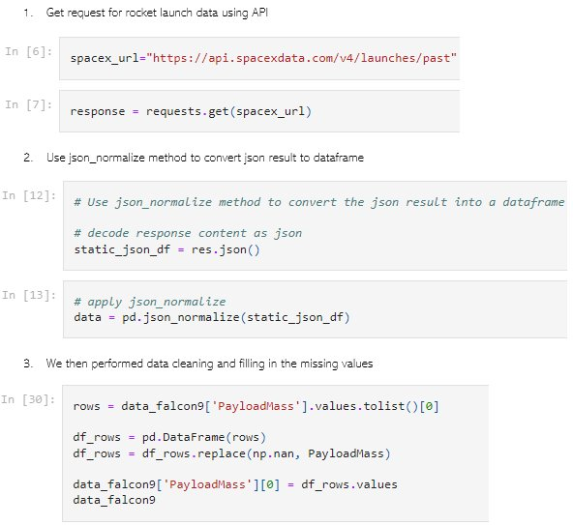
DATA COLLECTION VIA SPACE X API
🚀 Data Acquisition and Preparation
We initiated data collection using an HTTP GET request to the SpaceX API.
The response was parsed into JSON format and converted into a structured pandas dataframe.
Subsequently, we performed basic data cleaning, wrangling, and formatting to ensure consistency and usability for downstream analysis.
NOTEBOOK LINK BELOW:
https://github.com/Aali715/DATA-SCIENCE-CAPSTONE-PROJECT/blob/9d1ee33c7e06ff05fc0e58f5fe9e420f2c2969c2/jupyter-labs-spacex-data-collection-api.ipynb

Slide 8
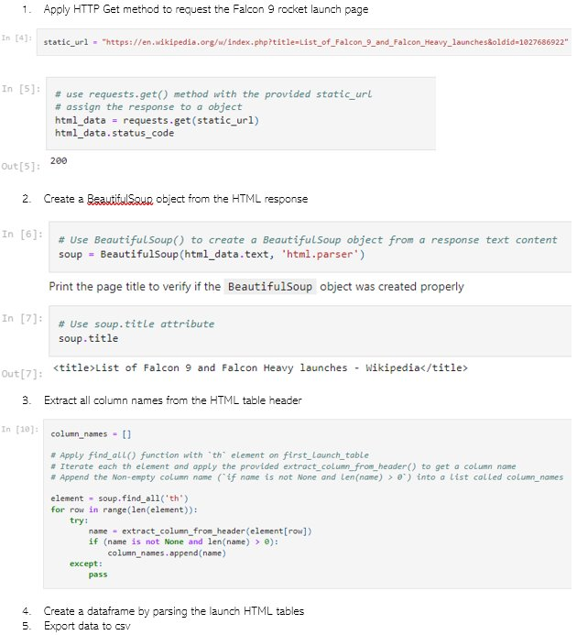
Data Collection Via Web Scraping
🌐 Web Scraping Falcon 9 Launch Records
To enrich our dataset, we applied web scraping techniques to extract historical Falcon 9 launch records from Wikipedia using the BeautifulSoup library.
We targeted the HTML table containing launch data, parsed its structure, and converted the extracted content into a structured pandas dataframe.
This supplementary data provided valuable insights for our analysis and model training.
LINK TO NOTEBOOK
https://github.com/Aali715/DATA-SCIENCE-CAPSTONE-PROJECT/blob/9d1ee33c7e06ff05fc0e58f5fe9e420f2c2969c2/jupyter-labs-webscraping.ipynb

Slide 9

DATA WRANGLING
📊 Exploratory Data Analysis and Label Preparation
We conducted exploratory data analysis to understand the distribution and characteristics of the launch dataset.
This included calculating the number of launches per site and analyzing the frequency and types of orbital paths.
To prepare the target variable for model training, we derived a binary landing outcome label from the original outcome column.
The processed results were then exported to a CSV file for further modeling.
LINK TO NOTEBOOK
https://github.com/Aali715/DATA-SCIENCE-CAPSTONE-PROJECT/blob/9d1ee33c7e06ff05fc0e58f5fe9e420f2c2969c2/labs-jupyter-spacex-Data%20wrangling.ipynb

Slide 10
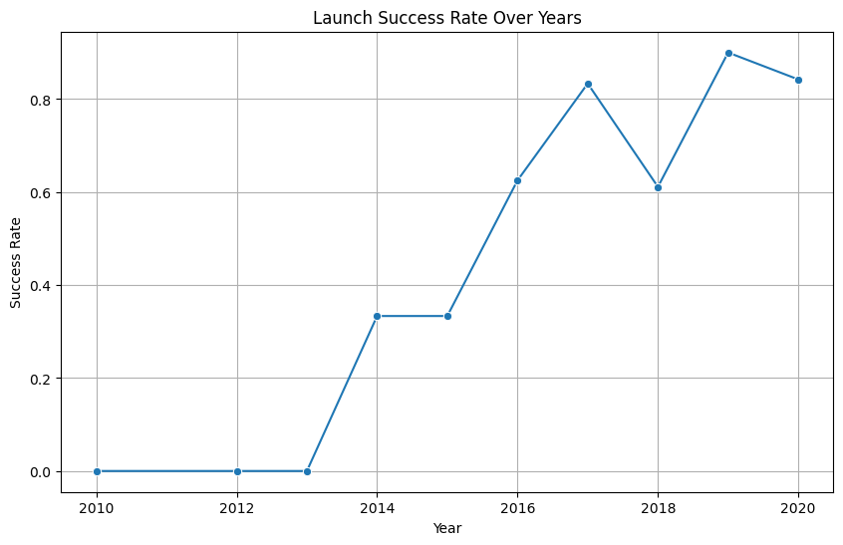
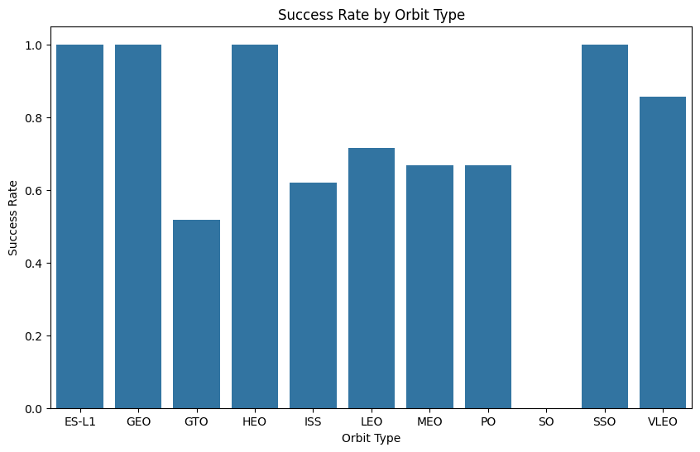
EDA with Data Visualization
We explored the dataset by generating visualizations to uncover key relationships and trends.
This included analyzing the correlation between flight number and launch site, payload mass and launch site, and the success rate across different orbit types.
We also examined how flight number relates to orbit type and visualized the yearly trend of launch success to identify temporal patterns.
LINK TO NOTEBOOK
https://github.com/Aali715/DATA-SCIENCE-CAPSTONE-PROJECT/blob/9d1ee33c7e06ff05fc0e58f5fe9e420f2c2969c2/edadataviz.ipynb

Slide 11
EDA WITH SQL
🗄️ SQL-Based Analysis in PostgreSQL
We seamlessly loaded the SpaceX dataset into a PostgreSQL database directly from the Jupyter Notebook environment.
Using SQL queries, we performed exploratory data analysis to extract key insights, including:
Identifying all unique launch sites involved in the missions
Calculating the total payload mass carried by boosters launched under NASA’s CRS program
Determining the average payload mass for missions using the F9 v1.1 booster version
Counting the total number of successful and failed mission outcomes
Investigating failed drone ship landings, including associated booster versions and launch site names
LINK TO NOTEBOOK
https://github.com/Aali715/DATA-SCIENCE-CAPSTONE-PROJECT/blob/9d1ee33c7e06ff05fc0e58f5fe9e420f2c2969c2/jupyter-labs-eda-sql-coursera_sqllite.ipynb

Slide 12
BUILD AN INTERACTIVE MAP WTH FOLIUM
🗺️ Geospatial Mapping and Proximity Analysis
We visualized all launch sites on a Folium map, enhancing it with interactive elements such as markers, circles, and lines to indicate the success or failure of each launch.
Launch outcomes were encoded as binary classes — 0 for failure and 1 for success — to support classification and visualization.
By leveraging color-coded marker clusters, we were able to visually assess which launch sites demonstrated higher success rates.
We also computed distances from each launch site to nearby infrastructure and natural features to answer key spatial questions, such as:
Are launch sites located near railways, highways, or coastlines?
Do launch sites maintain a certain distance from urban areas?
LINK TO NOTEBOOK
https://github.com/Aali715/DATA-SCIENCE-CAPSTONE-PROJECT/blob/9d1ee33c7e06ff05fc0e58f5fe9e420f2c2969c2/lab_jupyter_launch_site_location.ipynb

Slide 13
BUILD A DASHBOARD WITH PLOTLY DASH
📊 Interactive Dashboard with Plotly Dash
We developed an interactive dashboard using Plotly Dash to visualize key insights from the launch dataset.
The dashboard includes:
Pie charts illustrating the distribution of total launches across various launch sites.
Scatter plots depicting the relationship between launch outcomes and payload mass (in kilograms), segmented by booster version categories.
These visualizations enable dynamic exploration of launch performance and payload characteristics across different configurations.
LINK TO NOTEBOOK
https://github.com/Aali715/DATA-SCIENCE-CAPSTONE-PROJECT/blob/35cec9b1b0ecc4fa9a7db36c79c33ac0c398733e/app.py

Slide 14
Predictive Analysis (Classification)
🚀 Machine Learning Pipeline Summary
1. Data Loading & Preparation
Imported data using NumPy and Pandas.
Performed data transformation to clean and structure the dataset.
Split the dataset into training and testing sets for model evaluation.
2. Model Building & Tuning
Trained multiple classification models (e.g., Logistic Regression, Random Forest, SVM, etc.).
Used GridSearchCV to perform hyperparameter tuning, ensuring optimal model configurations.
3. Evaluation & Optimization
Chose accuracy as the primary evaluation metric.
Applied feature engineering techniques to enhance model performance.
Iteratively improved results through algorithm tuning.
4. Model Selection
Identified the best-performing classification model based on validation accuracy.
LINK TO NOTEBOOK
https://github.com/Aali715/DATA-SCIENCE-CAPSTONE-PROJECT/blob/250953ca1333d52c0b1b10ac90a8d10882697c7d/SpaceX_Machine%20Learning%20Prediction_Part_5.ipynb

Slide 15
RESULTS
Exploratory data analysis results
Interactive analytics demo in screenshots
Predictive analysis results

Slide 16
EDA WITH VISUALIZATION

Slide 17
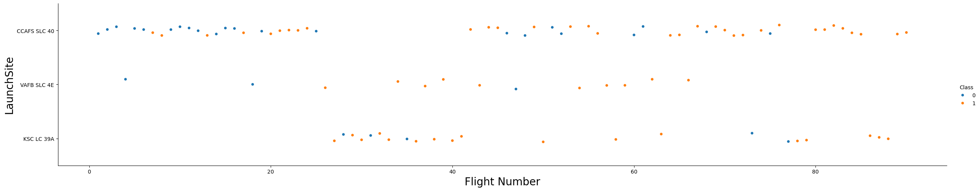
Flight Number vs. Launch Site
🚀 Launch Frequency vs. Success Rate
From the plotted data, we observed a positive correlation between the number of flights at a launch site and its success rate.
https://github.com/Aali715/DATA-SCIENCE-CAPSTONE-PROJECT/blob/35cec9b1b0ecc4fa9a7db36c79c33ac0c398733e/edadataviz.ipynb

Slide 18
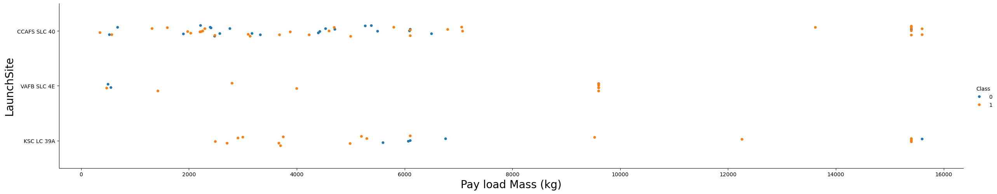
PAYLOAD VERSUS LAUNCH SITE
Payload Mass vs. Success Rate at CCAFS SLC 40
At Cape Canaveral’s SLC 40, rockets carrying heavier payloads are associated with higher success rates. This may reflect better mission planning, more robust rocket configurations, or selective launch conditions for heavier payloads.

Slide 19
SUCCESS RATE VERSUS ORBIT TYPE
🛰️ Orbit Type vs. Launch Success Rate
From the plotted data, we observed that the following orbit types — ES-L1, GEO, HEO, SSO, and VLEO — exhibited the highest success rates.

Slide 20
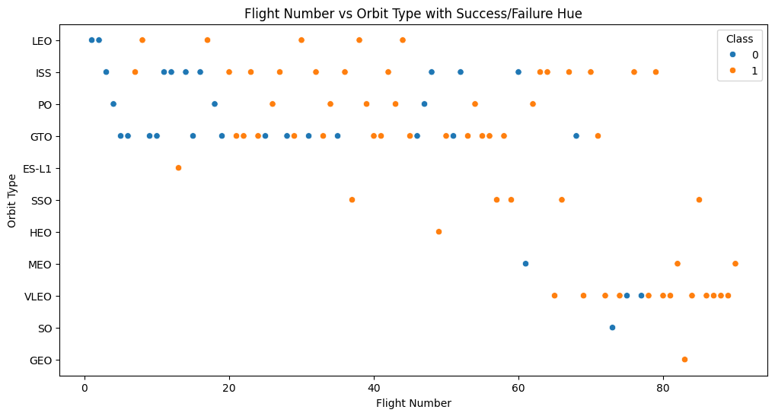
FLIGHT NUMBER vs. ORBIT TYPE
🛰️ Flight Number vs. Orbit Type
The plot reveals a notable trend in LEO (Low Earth Orbit) missions:
Higher flight numbers are generally associated with increased success rates, suggesting that operational experience and iterative improvements may enhance reliability for LEO launches.
In contrast, for GTO (Geostationary Transfer Orbit) missions:
There appears to be no clear correlation between flight number and success, indicating that other factors — such as mission complexity, payload characteristics, or external conditions — may play a more dominant role in determining outcomes.

Slide 21
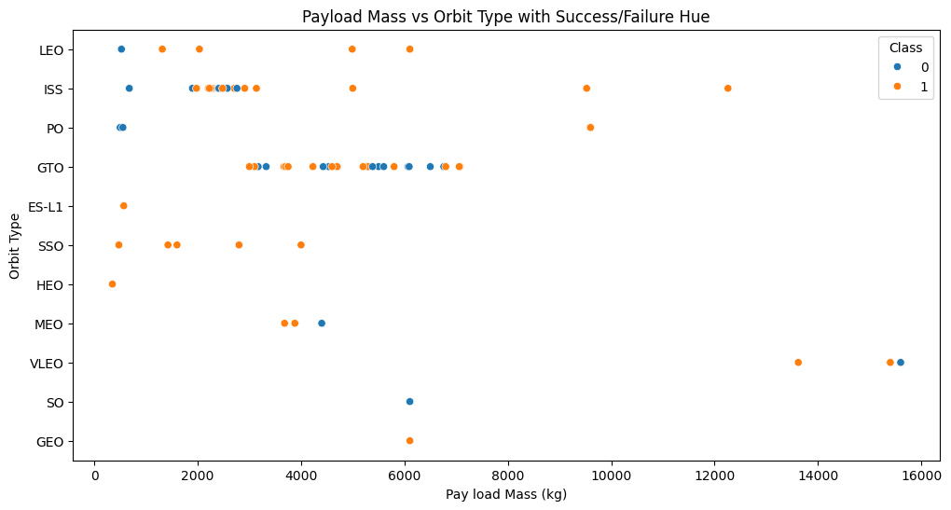
PAYLOAD vs. ORBIT TYPE
🛰️ Payload Mass vs. Orbit Type and Landing Success
The data suggests that heavier payloads are more frequently associated with successful landings when targeting the following orbits:
PO (Polar Orbit)
LEO (Low Earth Orbit)
ISS (International Space Station)
This trend may reflect the operational maturity and mission familiarity of these orbits, where robust planning, optimized rocket configurations, and refined landing protocols contribute to higher success rates — even under heavier payload conditions.

Slide 22
LAUNCH SUCCESS YEARLY TREND
📈 Temporal Trend in Launch Success (2013–2020)
The plotted data reveals a steady upward trend in launch success rates from 2013 through 2020.
This consistent improvement likely reflects SpaceX’s growing operational expertise, iterative engineering enhancements, and increased reliability of booster recovery systems over time.

Slide 23
EXOPLORATORY DATA ANALYSIS WITH SQL

Slide 24
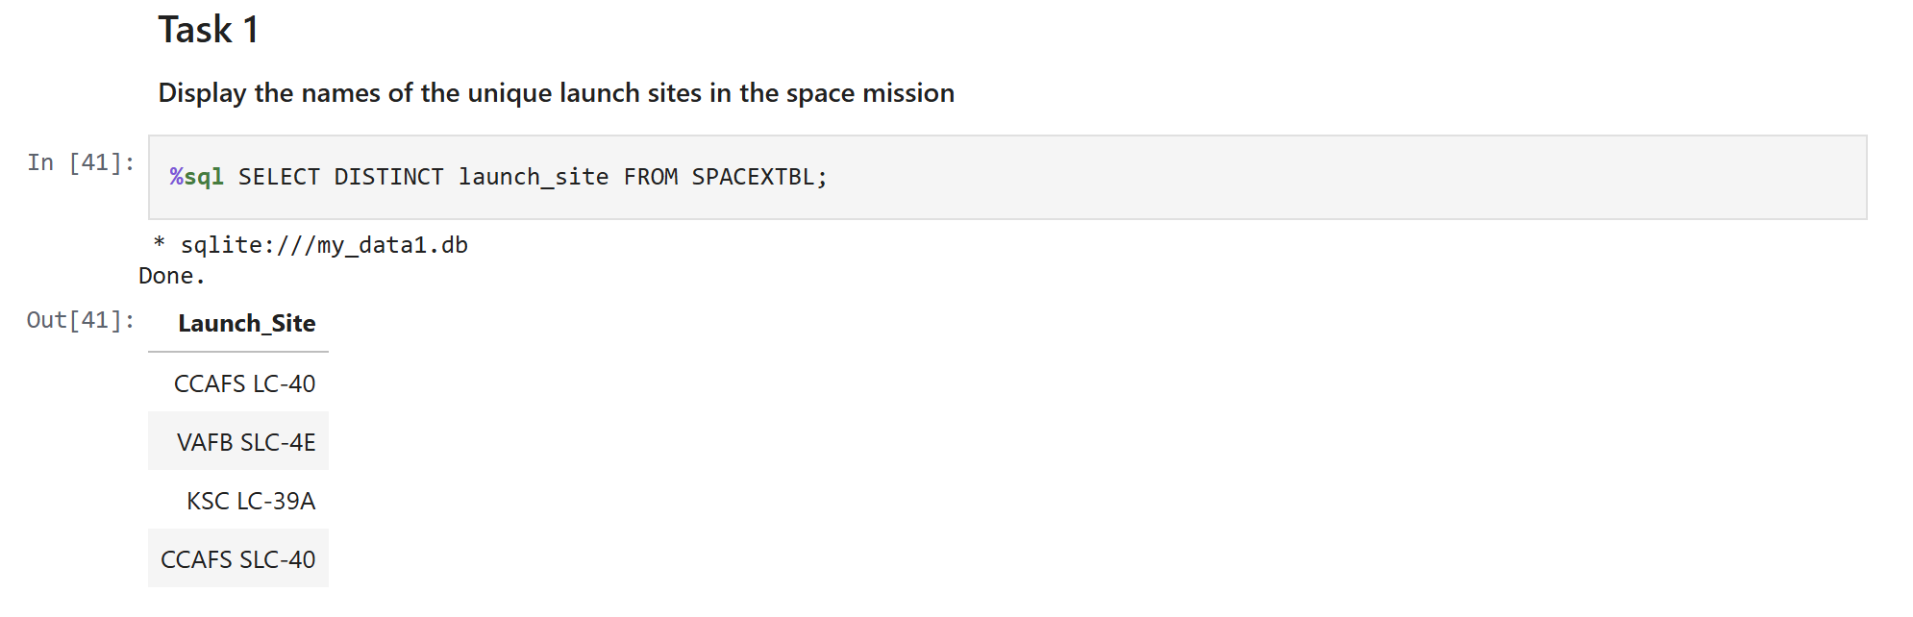
ALL LAUNCH SITE NAMES
🧮 Extracting Unique Launch Sites with SQL
To identify distinct launch sites from the SpaceX dataset, we used the SQL keyword DISTINCT. This ensures that each launch site appears only once in the query result, eliminating duplicate entries.

Slide 25
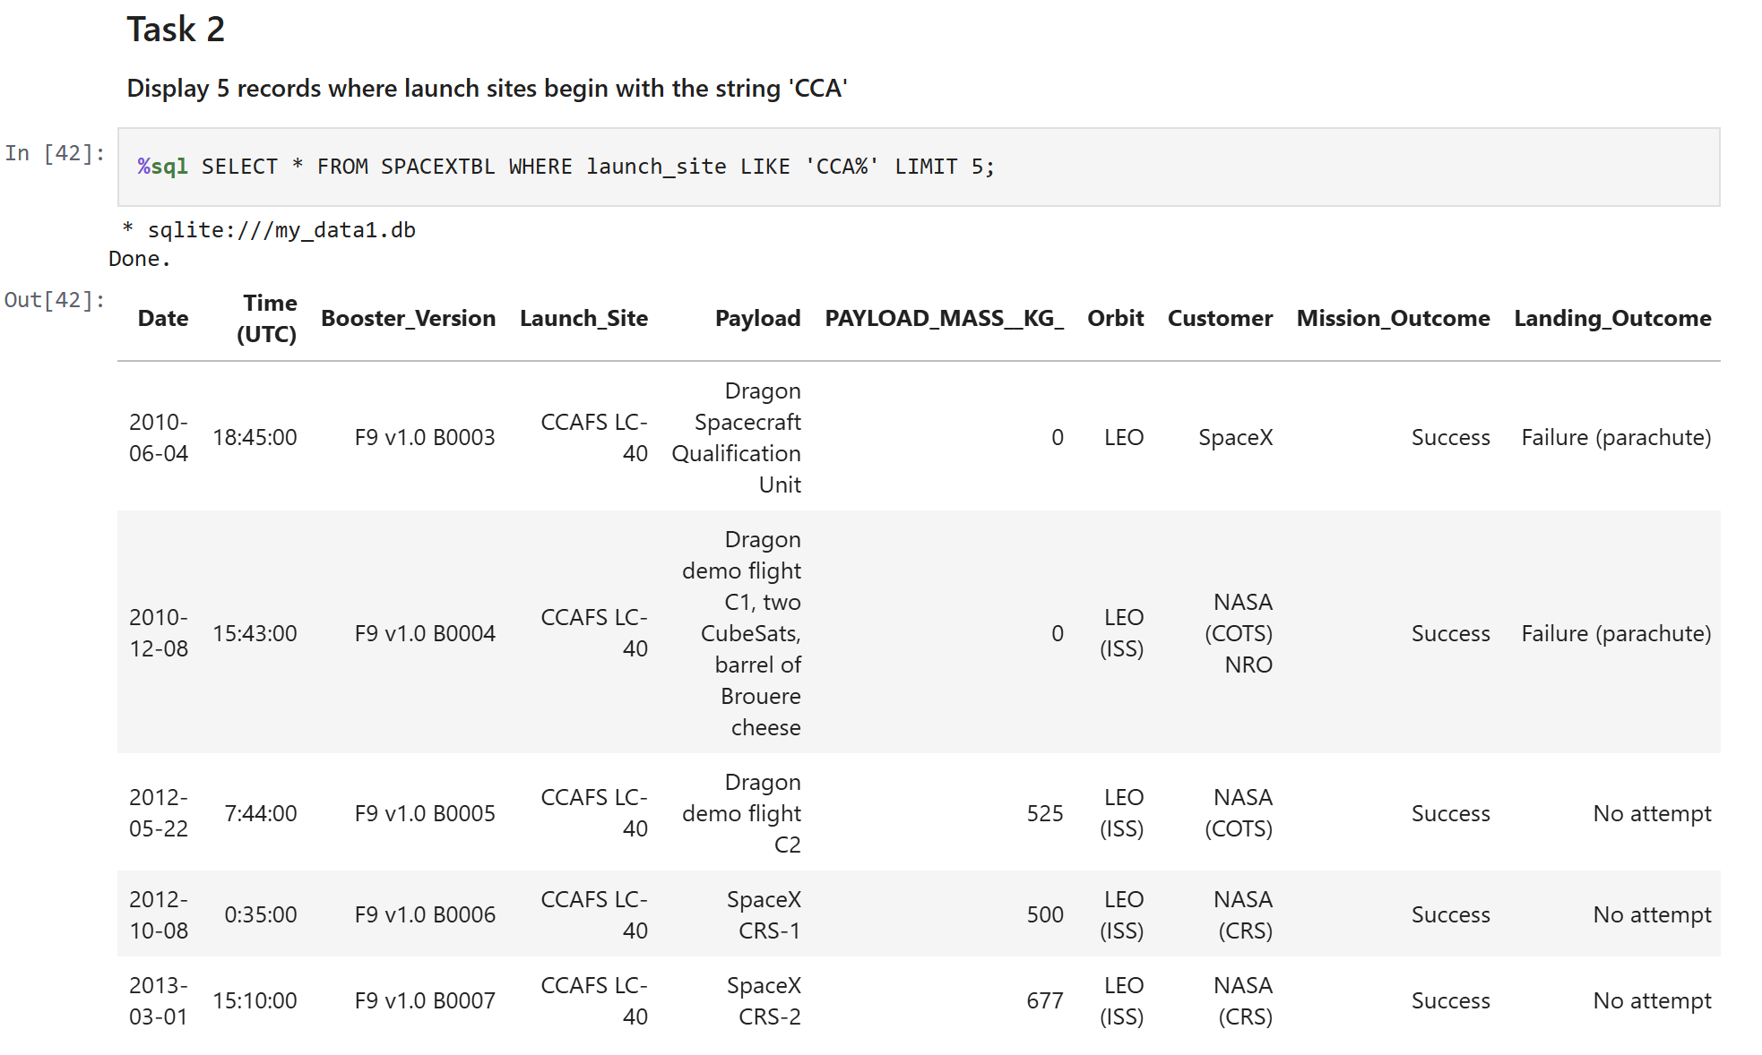
LAUNCH SITE NAMES BEGIN WITH 'CCA'
🔍 Filtering Launch Sites by Prefix
To retrieve a sample of launch sites that begin with 'CCA', we extended our previous query using the LIKE operator with a wildcard and limited the output to just 5 records for inspection.
LIKE 'CCA%' filters for launch site names that start with 'CCA'.
LIMIT 5 restricts the output to the first five matching records.
This query helps quickly verify the presence and format of launch sites associated with Cape Canaveral, such as 'CCAFS LC-40'.

Slide 26
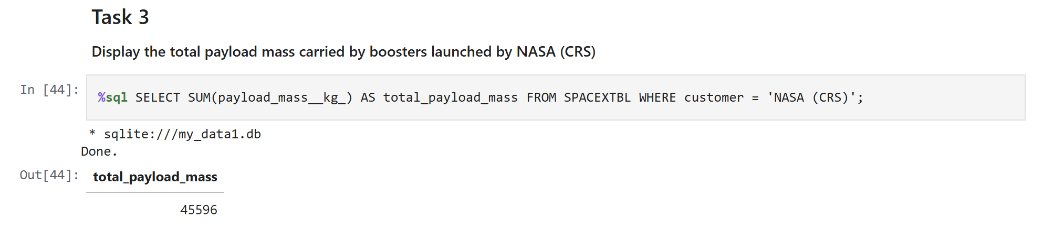
TOTAL PAYLOAD MASS
The SQL query returned a cumulative payload of 45,596 kg for NASA‑contracted booster missions.
WHERE Customer = 'NASA (CRS)' → filters the dataset to only NASA missions.
SUM(PayloadMass) → adds up all payload masses for those missions.
AS Total_Pay_load → labels the result column for clarity.

Slide 27
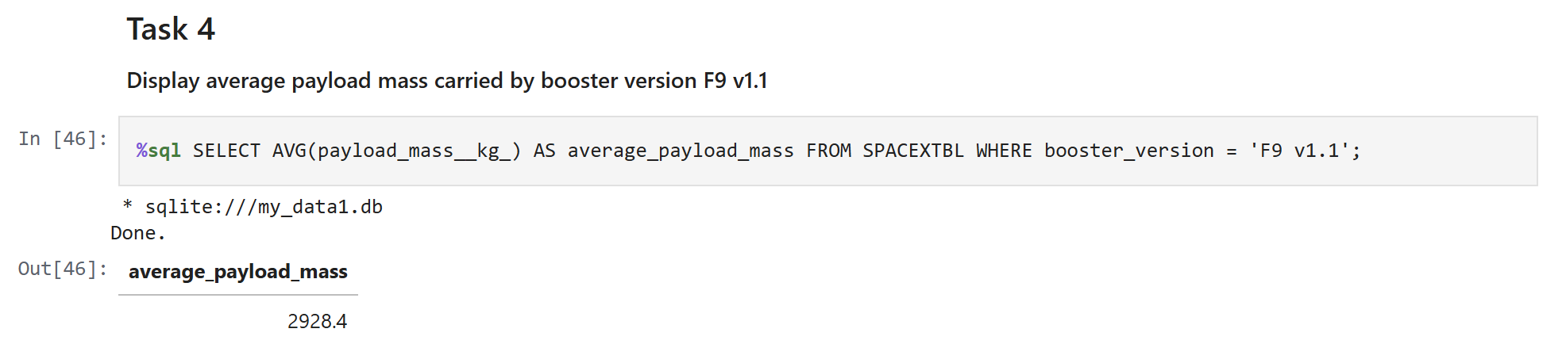
AVERAGE PAYLOAD MASS BY F9 v1.1
An aggregate SQL query was executed to determine the mean payload mass associated with Falcon 9 v1.1 booster missions. The computed average payload was approximately 2,928.4 kilograms.
Method → aggregate SQL query
Scope → Falcon 9 v1.1 booster missions
Result → 2,928.4 kg

Slide 28
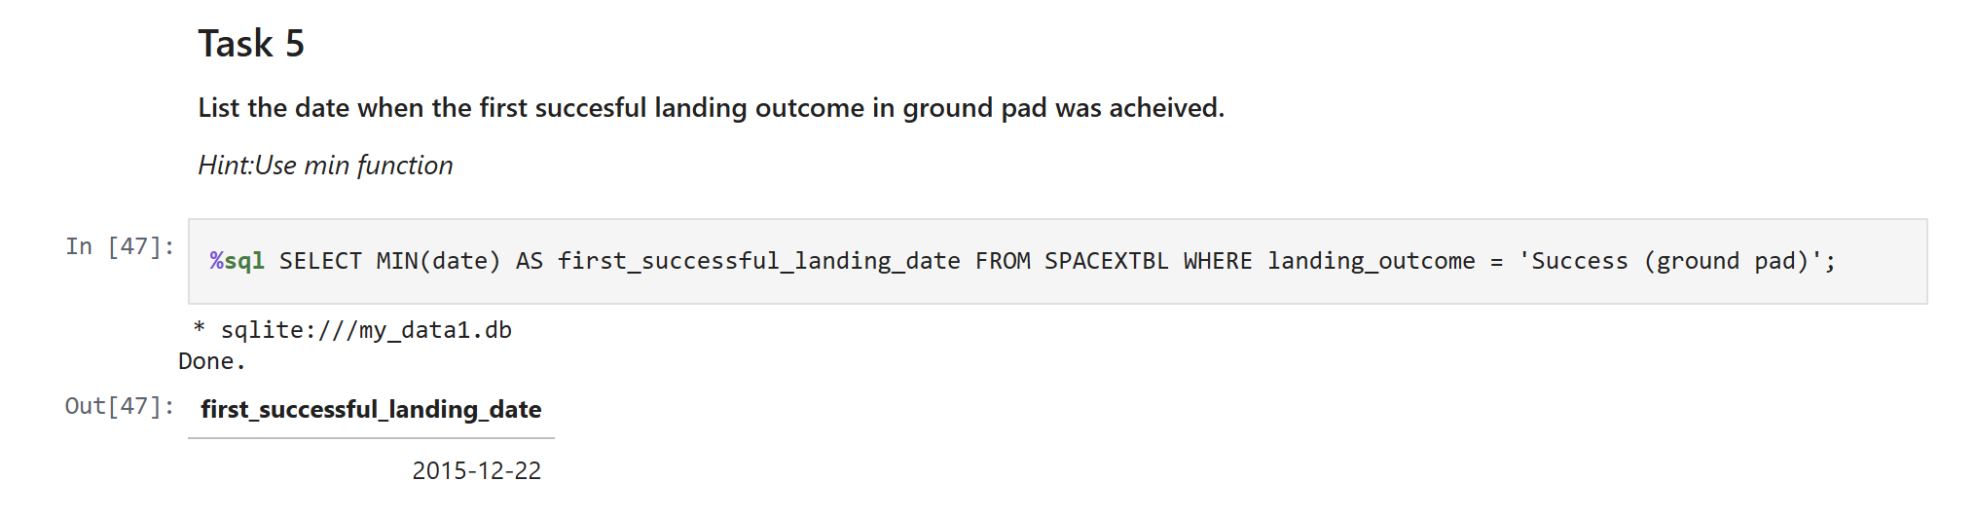
FIRST SUCCESS GROUND LANDING DATE
Our observation shows that the first ground pad landing success took place on December 22, 2015.

Slide 29
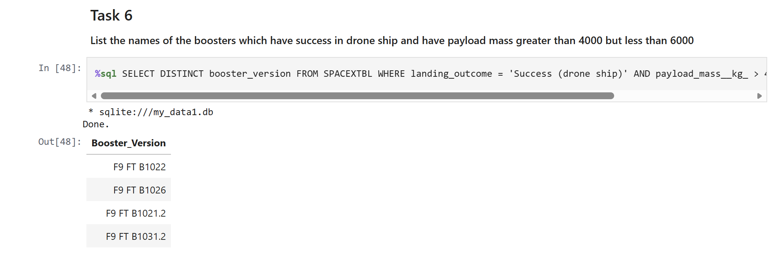
Successful Drone Ship Landing with Payload between4000 and 6000
A WHERE clause was applied to isolate boosters that achieved successful drone‑ship landings. An AND condition was then introduced to further constrain the results to missions with payload masses between 4,000 and 6,000 kilograms.
Method → filtering with WHERE
Criteria → success on drone ship
Constraint → payload mass range

Slide 30
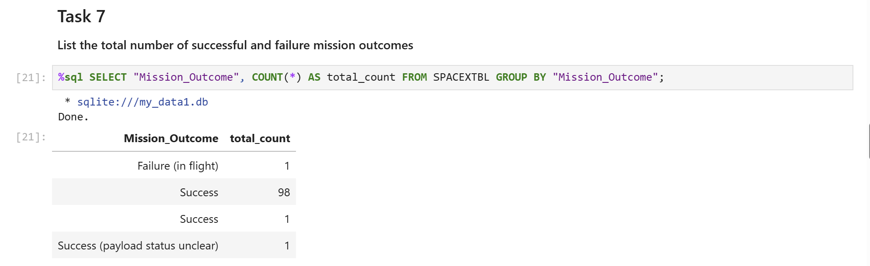
TOTAL NUMBER OF SUCCESSFUL AND FAILURE MISSION OUTCOMES
A wildcard operator (%) was applied within the WHERE clause to filter records where the MissionOutcome indicated either success or failure.

Slide 31
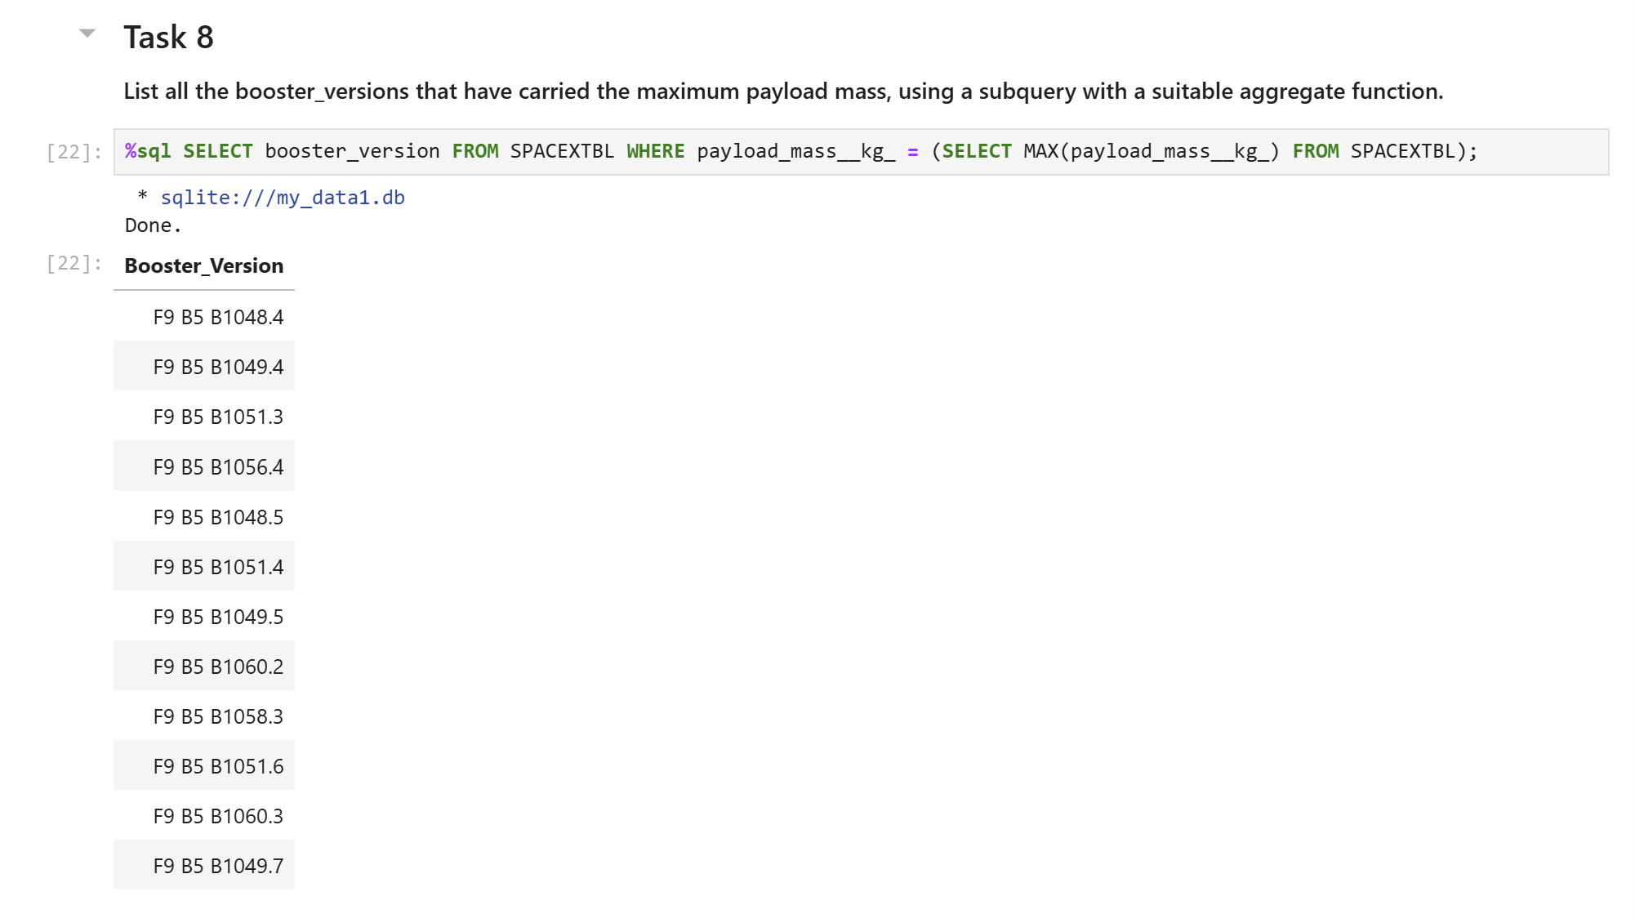
BOOSTERS CARRIERS MAXIMUM PAYLOAD
We identified the booster with the highest payload by combining a subquery in the WHERE clause with the MAX() function.

Slide 32
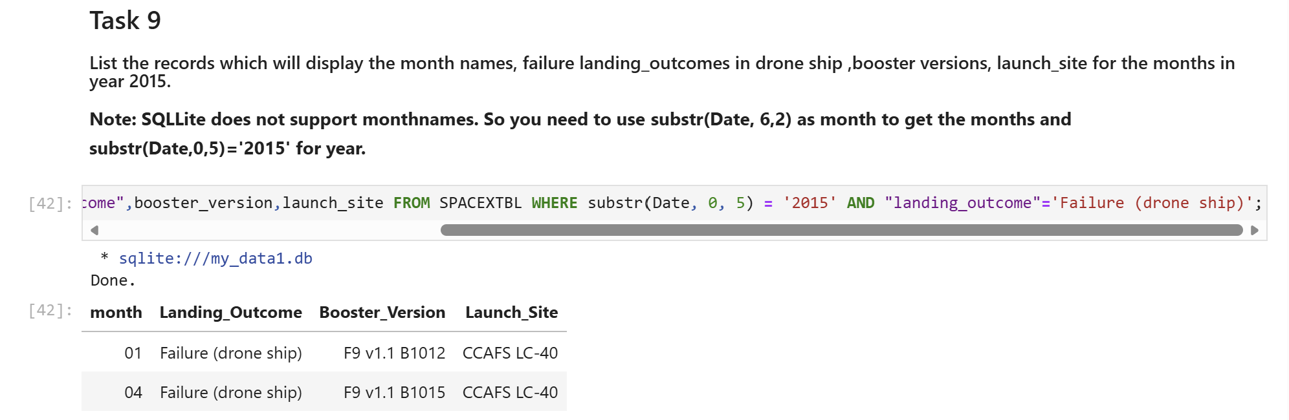
2015 LAUNCH RECORDS
A combination of WHERE, LIKE, AND, and BETWEEN conditions was employed to filter records of failed drone‑ship landings, along with their corresponding booster versions and launch site names, specifically for the year 2015.

Slide 33
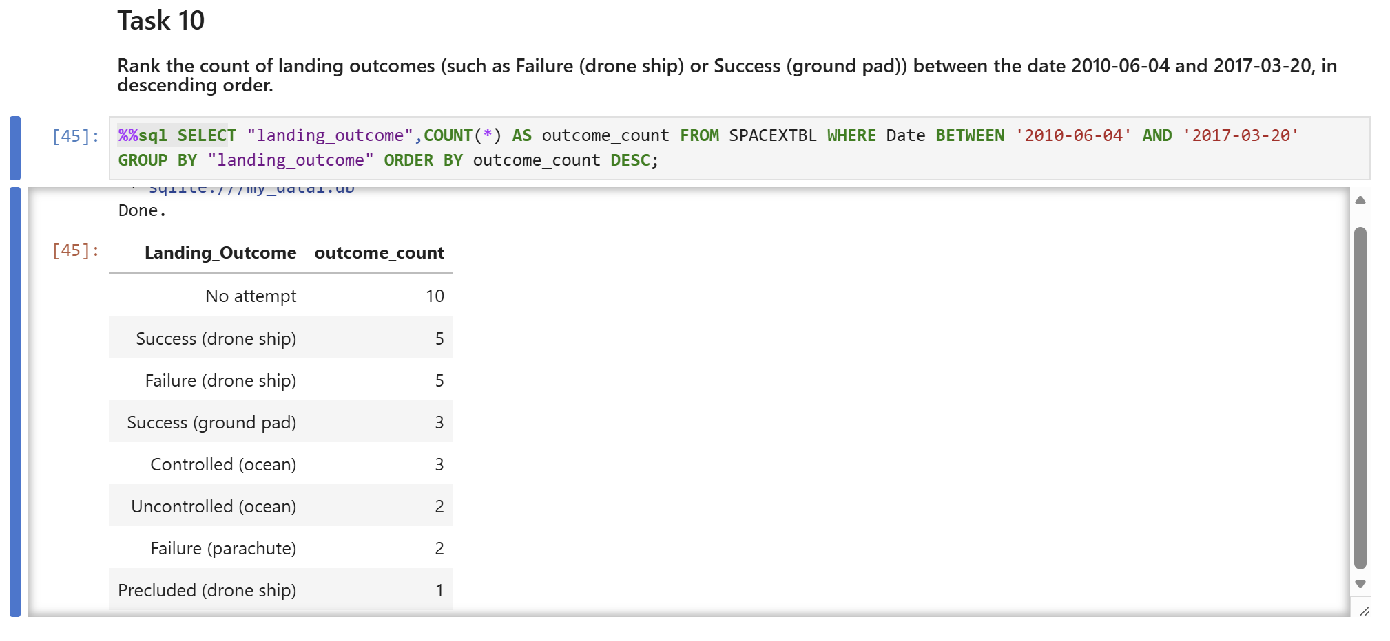
Rank Landing Outcomes Between 2010-06-04 and2017-03-20
We retrieved landing outcomes along with their counts, applying a WHERE clause to filter results within the date range from June 4, 2010 to March 20, 2017.
The GROUP BY clause was then used to categorize the landing outcomes, and the ORDER BY clause arranged these grouped results in descending order.

Slide 34
INTERACTIVE VISUAL ANALYTICS WITH FOLIUM

Slide 35

ALL LAUNCH SITES ON FOLIUM MAP
The launch sites are strategically located along the U.S. coasts to optimize orbital trajectories and ensure safe recovery zones.

Slide 36
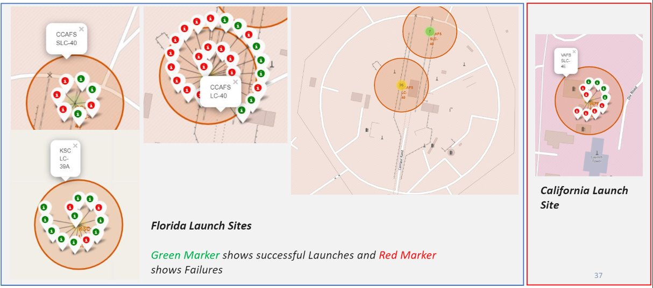
MARKERS SHOWING LAUNCH SITES WITH COLOR LABELS

Slide 37

LAUNCH SITE DISTANCE TO LANDMARKS

Slide 38
BUILD A DASHBOARD WITH PLOTLY DASH

Slide 39
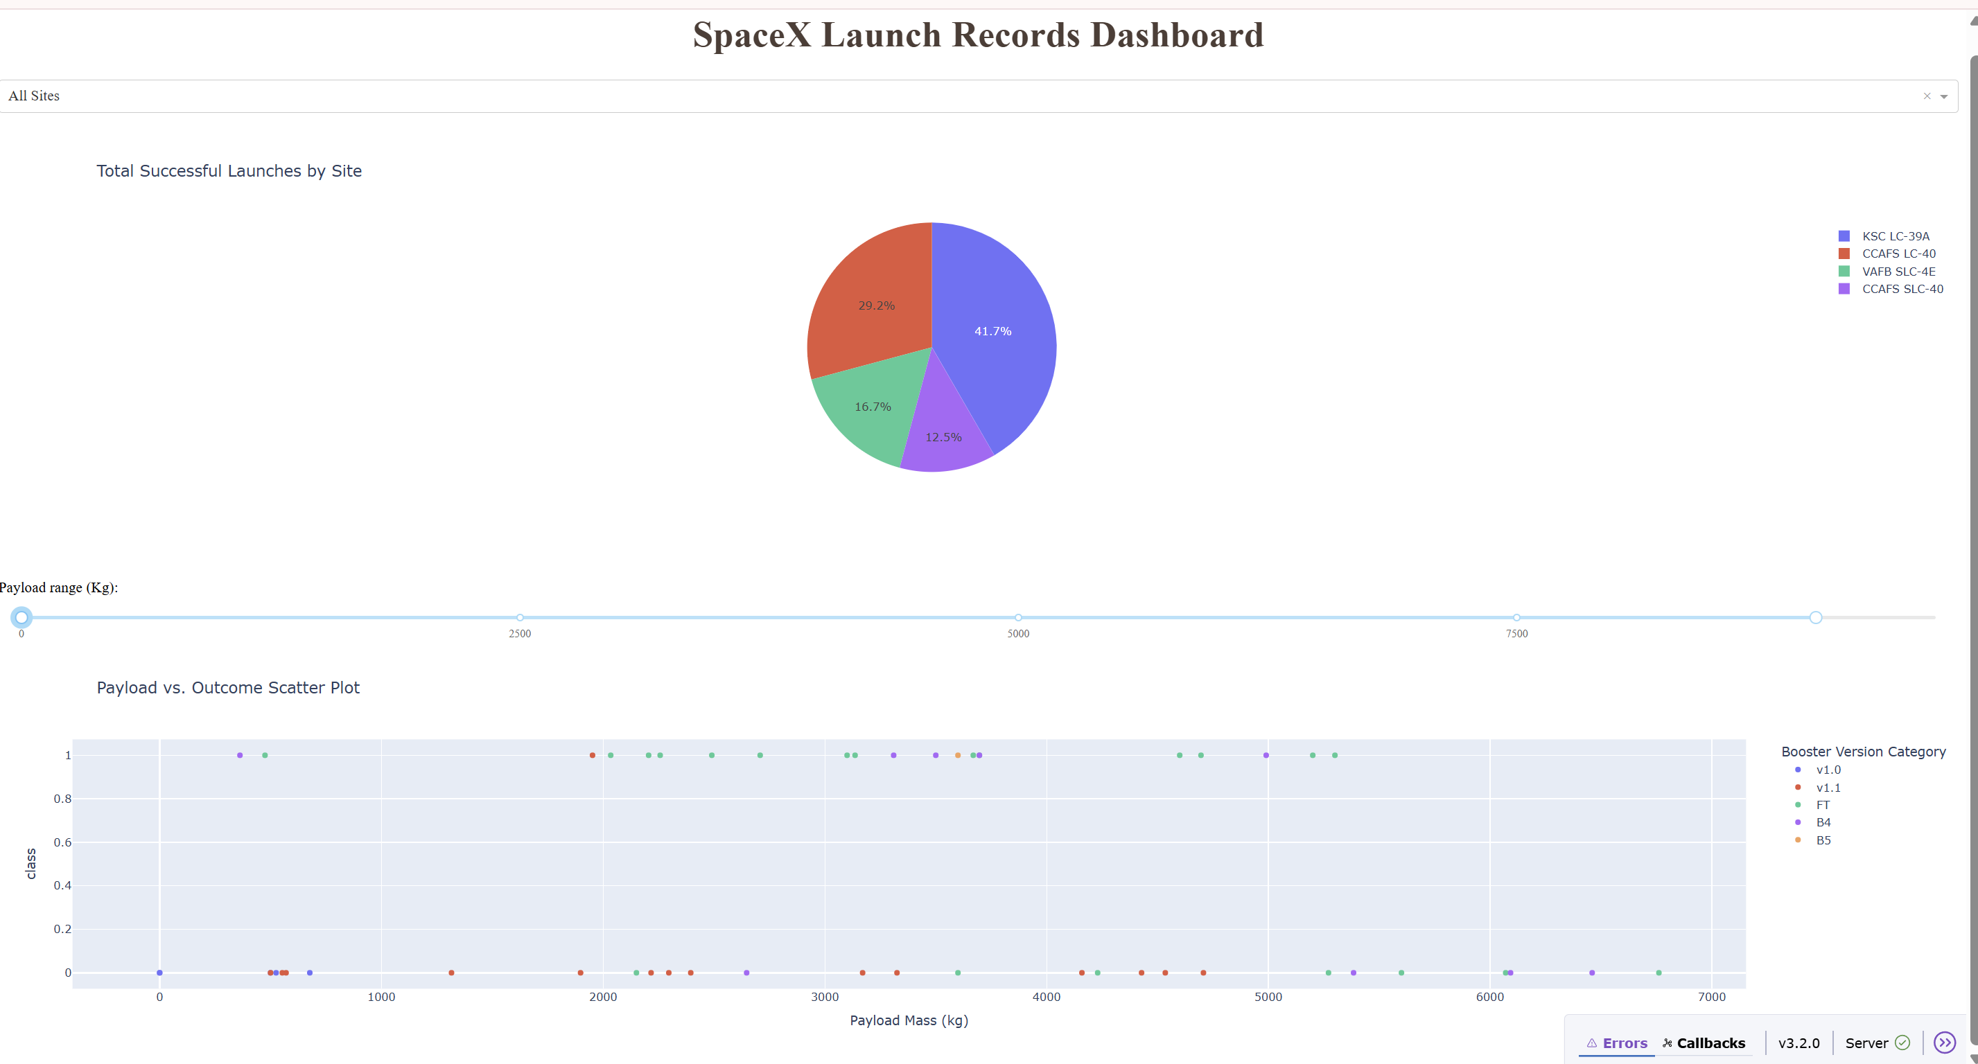
PIE CHART SHOWING THE SUCCESS OF EACH LAUNCH SITE IN %
Success Rate by Site: KSC LC‑39A leads with 41.7% of total successful launches, followed by CCAFS LC‑40 (29.2%), VAFB SLC‑4E (16.7%), and CCAFS SLC‑40 (12.5%).

Slide 40

PIE CHART DEPICTING THE LAUNCH SITE WITH THE HIGHEST LAUNCH SUCCESS RATIO
KSC LC-39A has a 76.9% success rate and a 23.1% failure rate

Slide 41
SCATTER PLOT OF PAYLOAD vs LAUNCH OUTCOME FOR ALL SITES, PAYLOAD IN RANGE SLIDER
🚀 Payload Mass vs. Launch Success Rate
To better understand how payload mass influences launch outcomes, we split the data into two categories:
1. Low Weighted Payloads (0–4000 kg)
Observation: Higher concentration of successful launches.
Insight: Missions with lighter payloads tend to have better reliability, possibly due to reduced mechanical stress and simpler launch configurations.
2. Heavy Weighted Payloads (4000–10000 kg)
Observation: More dispersed success rates with visible failures.
Insight: Heavier payloads may introduce greater complexity, increasing the likelihood of mission failure.
📊 Conclusion: Launch success rates are notably higher for lighter payloads, suggesting payload mass is a critical factor in mission planning and risk assessment.

Slide 42
PREDICTIVE ANALYSIS(CLASSIFICATION)

Slide 43
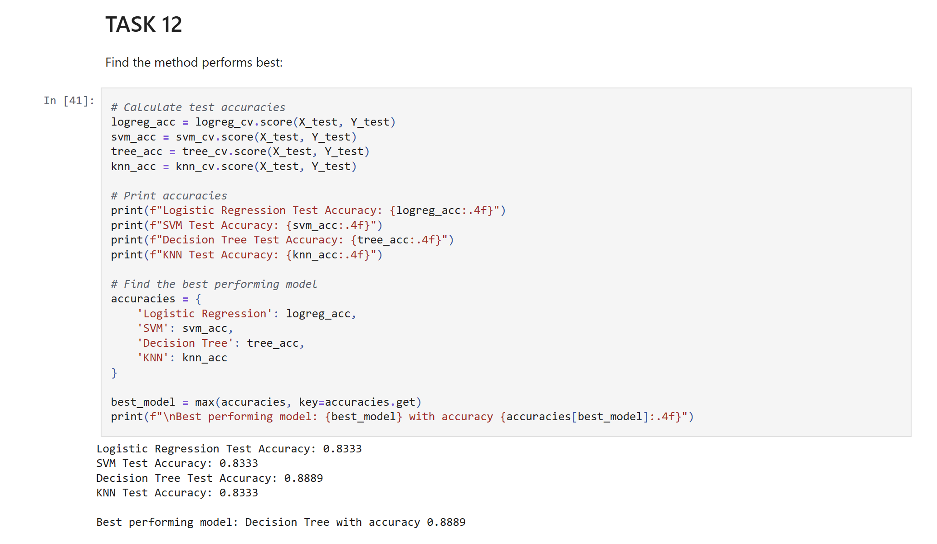
CLASSIFICATION ACCURACY
The decision tree classifier is the model with the highest classification accuracy
LINK TO NOTEBOOK
https://github.com/Aali715/DATA-SCIENCE-CAPSTONE-PROJECT/blob/250953ca1333d52c0b1b10ac90a8d10882697c7d/SpaceX_Machine%20Learning%20Prediction_Part_5.ipynb

Slide 44
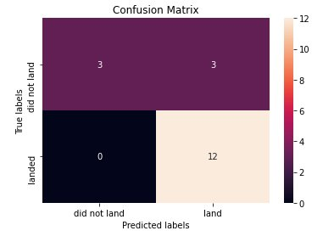
CONFUSION MATRIX
🌳 Decision Tree Classifier: Confusion Matrix Insights
The decision tree model demonstrates a solid ability to distinguish between successful and unsuccessful SpaceX landings, as reflected in the confusion matrix. However, a key issue emerges:
⚠️ False Positives
Definition: Instances where the model incorrectly predicts a successful landing for a launch that actually failed.
Count: 3 false positives out of 18 total predictions.
Impact: This type of error can be misleading for mission planning, as it overestimates reliability and may mask operational risks.
✅ Strengths
Zero false negatives: The model never misclassified a successful landing as a failure — excellent recall.
High true positive rate: 12 correct predictions for successful landings.
📌 Conclusion: While the decision tree classifier is effective at identifying successful landings, its tendency to overpredict success (false positives) highlights a need for improved precision — possibly through hyperparameter tuning or ensemble methods.

Slide 45
CONCLUSION
FINAL INNOVATIVE INSIGHTS & MODEL EVALUATION
Based on our comprehensive analysis of SpaceX launch data, we draw the following conclusions:
📈 Launch Trends & Site Performance
Flight Volume vs. Success Rate: Launch sites with higher flight frequencies tend to exhibit greater reliability, suggesting that operational experience and infrastructure maturity contribute to improved outcomes.
Temporal Trend: Launch success rates began rising steadily from 2013, peaking around 2020, reflecting technological advancements and process optimization.
Top Performing Site: KSC LC-39A recorded the highest number of successful launches, reinforcing its role as SpaceX’s most reliable launchpad.
🛰️ Orbit Type Reliability
Missions targeting ES-L1, GEO, HEO, SSO, and VLEO orbits showed the highest success rates, likely due to mature mission profiles and refined targeting protocols.
🤖 Model Selection
Among the tested algorithms, the Decision Tree Classifier emerged as the most effective for predicting landing outcomes.
It demonstrated strong class separation and high recall for successful landings.
Minor issues with false positives suggest potential for further tuning or ensemble enhancement.
📌 Conclusion: These insights not only inform launch planning and risk assessment but also support cost estimation and competitive bidding strategies against SpaceX.

Slide 46

APPENDIX

Slide 47
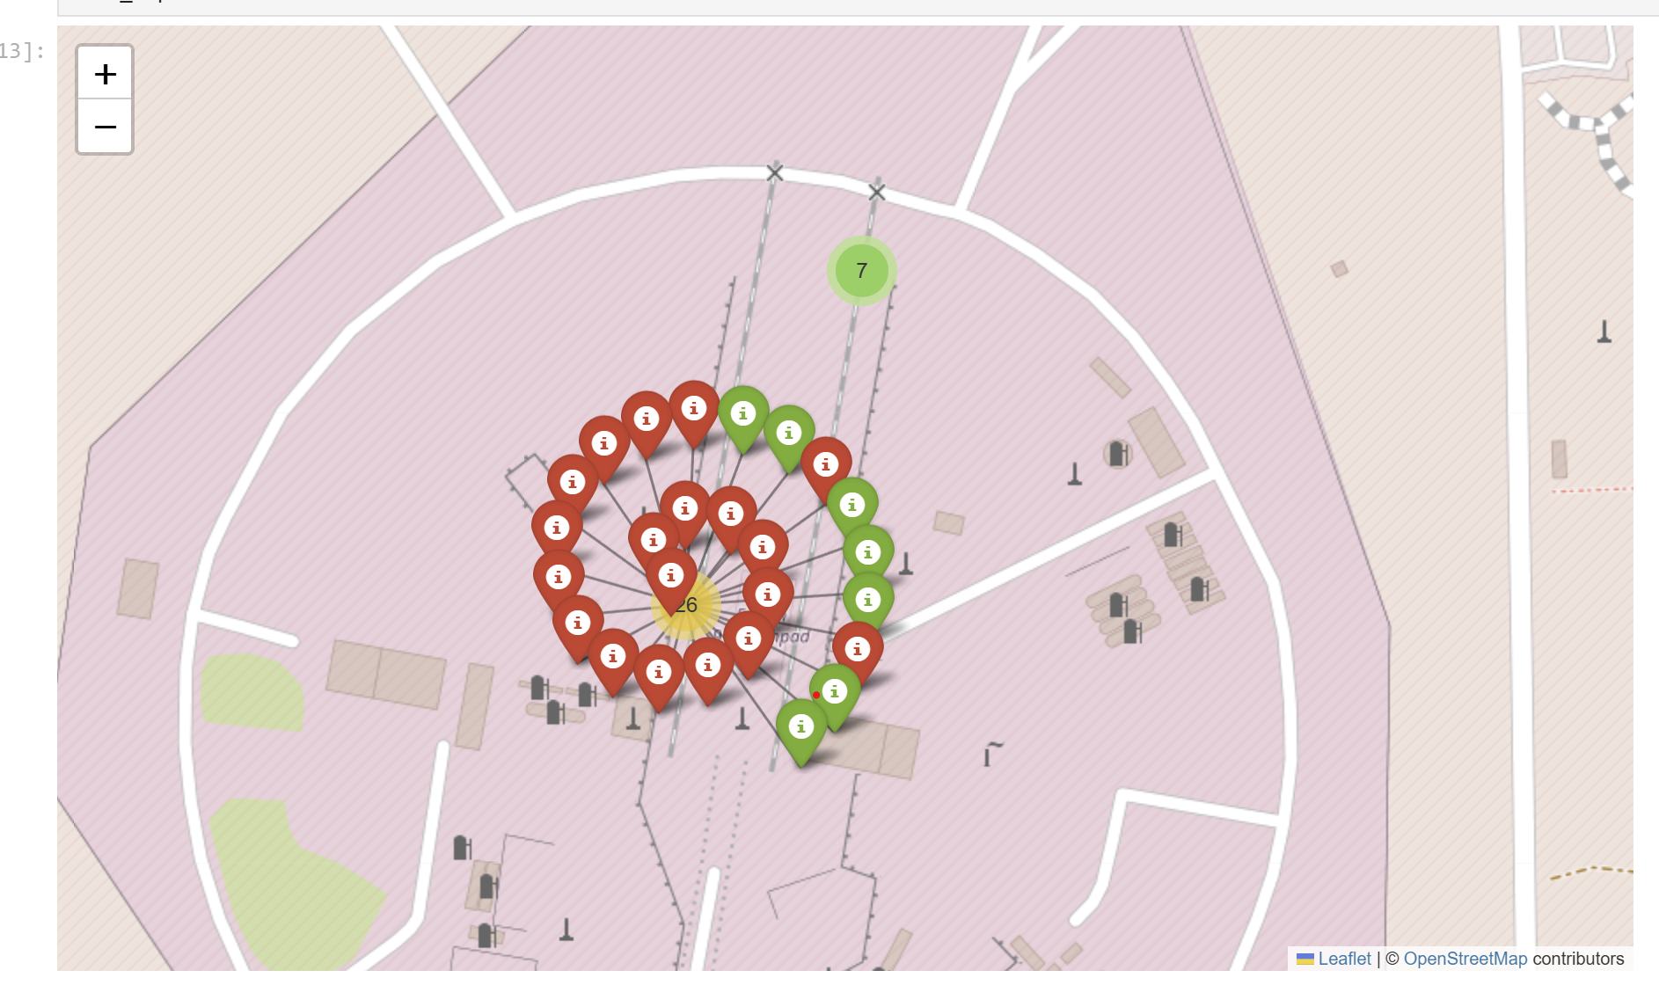
FOLIUM MAP WITH MARKERCLUSTER

Slide 48
THANK YOU

